Slide 1
DevOps Documentation
Muneer Ahmed J

Slide 2

Agenda
Flow Diagram
Branch Details
CI/CD/CT [Continuous Integration/ Deployment/ Testing] Process Details
Up Merge and Down Merge Details
Release Configuration
Jenkins Job Naming Convention
Building a Deployment Pipeline using Git, Maven, Jenkins and GlassFish
Continuous Integration/Deployment Delivery
Basic Git Bash commands

Slide 3
Flow Diagram
On approval, Promoting Build by picking artifacts from Nexus
Nexus Repository Manager
Master Branch
PROD
Higher Environments
CI/CD Pipeline
QA
Merging Release into Master
Create Release branch from Master
DEV
CI/CD Integration
Git Checkout
Sonar
Release Branch
Checkmarx
Legends
process involved
Approval
Execute Checkmarx every week
This process will be followed for every release
Create feature/hotfix branch from Release
Feature Branch -1
(Flex PM Task Branch)
Merge feature/hotfix branch to Release
Junit & BUILD
Checkmarx
Publish artifacts to Nexus
Feature Branch -2
(Flex PM Task Branch)
Deployment
Selenium Test
Hotfix/bugfix
Build Promotion

Slide 4
Branch Details
Master Branch:
This branch will contain the current PROD code changes.
Release Branch:
This branch will be checked out from Master branch by the developer which will contain the code changes for the current release.
Naming convention: release/{release number}
Example: release/1.0
Feature Branch:
This branch will be checked out from Release branch by the developer for developing the feature/story for the current release and it will be merged to release branch of the current release and moved sequentially from DEV to PROD.
Naming convention: feature/{flex PM task name}
Example: feature/108466-01

Slide 5
Branch Details(Contd.,)
HotFix Branch:
This branch will be checked out from Release branch by the developer for bugs/issues identified in DEV or QA Environment and it will be merged to release branch of current release and moved sequentially from DEV to PROD
Naming convention: hotfix/{bug name}
Example: hotfix/flex-okta-login-auth-issue.

Slide 6
CI/CD/CT Process Details
Current projects from SVN should be moved to Git. This will be the Master branch.
Release branch (may be 1.0) will be created off from Master.
Feature branch for every feature will be created off from Release branch.
Once code changes are done for the feature, feature branch should be merged to Release branch.
CI/CD Engine will checkout the code changes from Release branch and does the automated build and deployment with below process.
SONAR will be executed, and it will check for code quality issues/warnings.
Checkmarx will be executed, and it will run a security scan for checking any vulnerability in the code. Additionally Checkmarx will be triggered for every 15 days to avoid security issues.
Junit will be executed, and it will run the unit tests.
Nexus Repository Manager will be triggered & it will upload the artifacts into defined Nexus Repository.
Once all the above process is successful, changes will be deployed into the DEV Environment and email will be triggered for Application users and a separate email will be triggered for Build Promotion.

Slide 7
CI/CD/CT Process Details(Contd.,)
Once Build Promotion is approved for QA Environment,
Selenium test cases will be executed
Artifacts generated during DEV Build will be downloaded from Nexus Repository and will be deployed to QA Environment & triggers a mail for PROD Promotion.
Once Build Promotion is approved for PROD Environment
Artifacts generated during DEV Build will be downloaded from Nexus Repository and will be deployed to PROD Environment.
Once PROD Deployment is completed, below steps needs to be done.
Changes from Release should be Up merged to Master.
Version in the pom.xml should be incremented.
New Release branch (may be 2.0 or 3.0) should be created from old release branch (may be 1.0) and that new release branch should be used in the current release cycle.
Jenkins Jobs for the next release should be created in Jenkins.

Slide 8
Up Merge and Down Merge
Up Merge
Consider a scenario where release/1.0 is deployed into production & developers started working on release/2.0 and there is a production issue occurred in 1.0. In this case, developers need to take a hotfix branch out of release/1.0, perform the code fix & UT and merge it into release/1.0 as well as into release/2.0.
Impacts:
If the hotfix branch is not merged into release/2.0, same production issue will occur during release/2.0 deployment.
Down Merge:
Consider a scenario where team is working simultaneously on two releases, release/1.0 and release/2.0. If there are changes/enhancements as part of release/2.0 that needs to be incorporated globally, (for example: moving static contents to properties files or server changes) then that particular changes should be down merged to release/1.0 also.

Slide 9
Release Configuration
For every Release, below configurations needs to be done in Jenkins/Code Base
New Release branch from existing release branch
Increment the version in pom.xml
New Jenkins Job for the new release branch
Configure the new release branch in Git Plugin
Configure the new release branch in SonarQube & Checkmarx plugin.

Slide 10
Jenkins Jobs Naming Convention
Jenkins Job for Build:
Naming Convention: <Project Name>_<release-number>-BUILD
Example: ePO-release_1.0-BUILD
Jenkins Job for Deploy:
Naming Convention: <Project Name>_<release-number>-<Environment>_DEPLOY
Example: ePO-release_1.0-DEV_DEPLOY
Jenkins Job for Promotion:
Naming Convention: <Project Name>_<release-number>-<Environment>_PROMOTION_JOB
Example: ePO-release_1.0-QA_PROMOTION_JOB

Slide 11
Jenkins Jobs Naming Convention (Contd.,)
Jenkins Job for Utility:
Naming Convention: <Project Name>_<release-number>-<Environment>_<Utility Name>
Example: ePO-release_1.0-QA_executeSeleniumTests

Slide 12
Gaps/R&D
Adding Up Merge & down Merge content alerts during build approval mail.
Automating the SONAR & Checkmarx paths during New Release.

Slide 13
Building a Deployment Pipeline using Git, Maven, Jenkins and GlassFish
Develop
Manage
Build & Test
Host
Eclipse IDE
Commit
Git Repository
Jenkins CI Server
Glassfish Dev Environment
Clone
Deploy
Fetch
Update
Deploy
Deploy
Glassfish Testing Environment
JUnit
Test
Glassfish Production Environment
Maven
Manage Build & Dependency

Slide 14
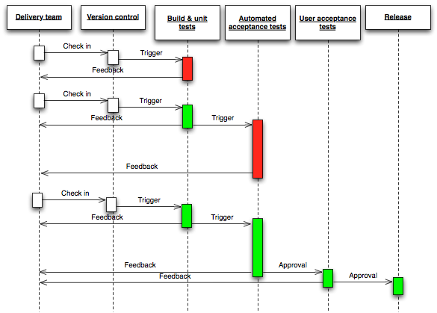
Continuous Integration/Deployment - Workflow

Slide 15
Basic Git Bash commands
For cloning a project from Git to Local machine.
git clone <clone_url>. This will always clone and install the master branch.
2. For cloning a specific branch from Git to Local machine.
git clone <clone_url> -b <branch_name>
3. To view the list of new or modified/changed files that you have made in your local repository.
git status
4. Git Staging - To stage/add all the files
git add .
5. Git Staging - To stage/add only the specific files
git add <file_name>

Slide 16
Basic Git Bash commands (Contd.,)
6. Git committing the staged files with message
git commit -m ‘<commit_message>’. This will commit the changes to your local machine repository.
7. Git pushing the committed files into Git
git push origin <branch_name>
8. Git Pull command for pulling the latest changes from git.
git pull

Slide 17
Basic Git Bash commands
6. To pull the latest changes from remote repository
git pull
7. Git Push
git push
Alternatively, we can make use of Tortoise Git tool for managing all the above commands.

Slide 18
Thank you!

